Slide 1
Mozilla MVP Summer Lab
FTI POC
Abdul Aziz Ali

Slide 2
One Day….
Notes:
One Day, i needed to find a plumber to fix my wonky kitchen sink which had a pipe leak (sink)

Slide 3
One Day….
Notes:
One Day, i needed to find a plumber to fix my wonky kitchen sink which had a pipe leak (sink)

Slide 4
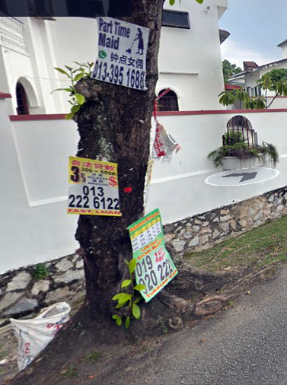
One Day….
Notes:
I saw a convenient roadside banner and called up the number (roadside)

Slide 5
One Day….
Notes:
The guy said 'yeah you have to pay me RM$50 just to come, OK?' (face)
I reluctantly agreed (face OK)

Slide 6
One Day….
Notes:
The guy said 'yeah you have to pay me RM$50 just to come, OK?' (face)
I reluctantly agreed (face OK)

Slide 7
One Day….
Notes:
I reluctantly agreed (face OK)

Slide 8
One Day….
Notes:
The guy came the next day, he looked at my sink for two minutes and immediately quoted me rm$600 (ya 600)

Slide 9
One Day….
Notes:
The guy came the next day, he looked at my sink for two minutes and immediately quoted me rm$600 (ya 600)
I didnt say a word (thats too much)
He still demanded rm$50 from me for doing (almost) nothing
I never called him after that.
Afterwards I so wanted to paste a large sign over that roadside banner, 'dont call this guy he charges money for doing nothing'
(even though i agreed)

Slide 10
One Day….
Notes:
I didnt say a word (thats too much)
He still demanded rm$50 from me for doing (almost) nothing
I never called him after that.
Afterwards I so wanted to paste a large sign over that roadside banner, 'dont call this guy he charges money for doing nothing'
(even though i agreed)

Slide 11
One Day….
Notes:
He still demanded rm$50 from me for doing (almost) nothing
I never called him after that.
Afterwards I so wanted to paste a large sign over that roadside banner, 'dont call this guy he charges money for doing nothing'
(even though i agreed)

Slide 12
One Day….
Notes:
Afterwards I so wanted to paste a large sign over that roadside banner, 'dont call this guy he charges money for doing nothing'
(even though i agreed)

Slide 13
One Day….
Notes:
Afterwards I so wanted to paste a large sign over that roadside banner, 'dont call this guy he charges money for doing nothing'

Slide 14
One Day….
I didnt
Notes:
Afterwards I so wanted to paste a large sign over that roadside banner, 'dont call this guy he charges money for doing nothing'

Slide 15

Consumer protection
ConsumerReports.org, Better Business Bureau
Notes:
If we look for something of the like on the internet
we have consumer protection websites consumerreports.org where consumers can report on products or services
not so much advertising though
The closest one may find in regards to consumer voice for advertising are by the advertisers themselves
GoogleAds, Criteo

Slide 16

Consumer protection
ConsumerReports.org, Better Business Bureau
Trustpilot, Web of Trust, Uservoice
Notes:
If we look for something of the like on the internet
we have consumer protection websites consumerreports.org where consumers can report on products or services
not so much advertising though
The closest one may find in regards to consumer voice for advertising are by the advertisers themselves
GoogleAds, Criteo

Slide 17



Consumer protection
ConsumerReports.org, Better Business Bureau
Trustpilot, Web of Trust
Google Ads, Criteo, YourAdChoices
Notes:
If we look for something of the like on the internet
we have consumer protection websites consumerreports.org where consumers can report on products or services
not so much advertising though
The closest one may find in regards to consumer voice for advertising are by the advertisers themselves
GoogleAds, Criteo

Slide 18
Consumer protection
ConsumerReports.org, Better Business Bureau
Trustpilot, Web of Trust
Google Ads, Criteo, YourAdChoices
Notes:
If we look for something of the like on the internet
we have consumer protection websites consumerreports.org where consumers can report on products or services
not so much advertising though
The closest one may find in regards to consumer voice for advertising are by the advertisers themselves
GoogleAds, Criteo

Slide 19
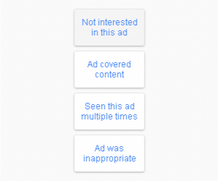
Consumer protection
Google Ads, Criteo, YourAdChoices
Notes:
If we look for something of the like on the internet
we have consumer protection websites consumerreports.org where consumers can report on products or services
not so much advertising though
The closest one may find in regards to consumer voice for advertising are by the advertisers themselves
GoogleAds, Criteo

Slide 20
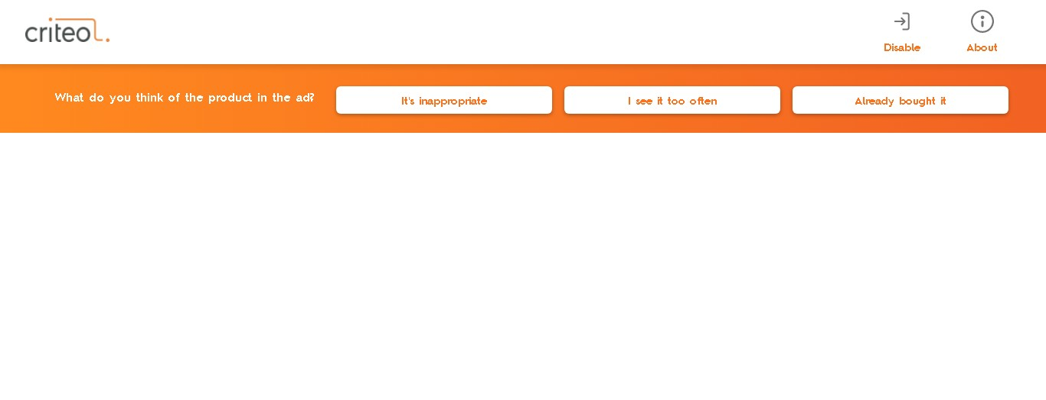
Consumer protection
Google Ads, Criteo, YourAdChoices
Notes:
If we look for something of the like on the internet
we have consumer protection websites consumerreports.org where consumers can report on products or services
not so much advertising though
The closest one may find in regards to consumer voice for advertising are by the advertisers themselves
GoogleAds, Criteo

Slide 21
Consumer to Consumer Advert Advisory with Web Annotations
Ad Network
Ad
Metrics
Content Site
Unable to
modify reviews
Annotation Server
Reviews
Annotation Extension
Ad
In-Situ Ad reviews
dialog
FTI POC
Notes:
To cut to the chase the service that we propose is a consumer to consumer and possibly to advertiser communication tool for adverts employing web annotations.

Slide 22
Advertising and Communications
Ad Network
Ad Network
Ad
Metrics
Ad
Metrics
Content Site
Unable to
modify reviews
Annotation Server
Content Site
Reviews
Annotation Extension
Ad
Ad
In-Situ Ad reviews
dialog
FTI POC
Traditional Advert
Consumption
Notes:
Advertising may be regarded as a type of communication.

Slide 23
Advertising and Communications
Ad Network
Ad Network
Ad Network
Movie Network
Google Ads Network
Ad Network
Movie
Network
Movie Network
Movie Network
Modify
Review
Ad
Ad
Ad
Metrics
Ad
Metrics
Movie
Metrics
Ad
Why I don’t like It
Ad
Metrics
Movie
Movie
Why I don’t like It
Movie
Why I don’t like It
Metrics
Content Site
Content Site
Unable to
modify reviews
Annotation Server
Content Site
Content Site
Review Site
Content Site
Content Site
Content Site
Content Site
Content Site
Reviews
Review
Review
Annotation Extension
Ad
Ad
Ad
Ad
Ad
Movie
Movie review
Ad
Why I don’t like It
Movie
Movie
Movie review
Movie
Movie review
Adblock
In-Situ Ad reviews
dialog
Dialog
Movie review
FTI POC
Dialog
Dialog
Traditional Advert
Consumption
Notes:
Dialogue is also a type of communication. (venn)

Slide 24
Advertising and Communications
Ad Network
Ad Network
Google Ads Network
Ad
Metrics
Ad
Metrics
Ad
Why I don’t like It
Content Site
Unable to
modify reviews
Annotation Server
Content Site
Content Site
Reviews
Annotation Extension
Ad
Ad
Ad
Why I don’t like It
In-Situ Ad reviews
dialog
FTI POC
Traditional Advert
Consumption
Google Ads Advert
Consumption
Notes:
One marked difference between advertising and dialogue is that advertising
is traditionally asymmetrical and dialogue is traditionally symmetrical
But it may be reasoned some advertising networks are to a limited degree symmetrical

Slide 25
Advertising and Communications
Ad Network
Ad Network
Movie
Network
Ad
Metrics
Ad
Metrics
Movie
Metrics
Content Site
Unable to
modify reviews
Annotation Server
Content Site
Content Site
Reviews
Annotation Extension
Ad
Ad
Movie
In-Situ Ad reviews
dialog
FTI POC
Traditional Advert
Consumption
Traditional Cultural
Consumption
Notes:
Cultural artifacts like movies or books can also be seen as asymmetrical types of communication.
But the difference between movies or books and advertising is that for the most part common people dont go look for and enjoy adverts like how they do movies or books.

Slide 26
Advertising and Communications
Ad Network
Ad Network
Movie
Network
Movie Network
Ad
Metrics
Ad
Metrics
Movie
Metrics
Movie
Metrics
Content Site
Unable to
modify reviews
Annotation Server
Content Site
Content Site
Content Site
Review Site
Reviews
Annotation Extension
Ad
Ad
Movie
Movie
Movie review
In-Situ Ad reviews
dialog
Movie review
FTI POC
Dialog
Traditional Advert
Consumption
Asymmetrical Cultural
Consumption
Symmetrical Cultural
Consumption
Notes:
The commonest form of symmetry are external review sites

Slide 27
Advertising and Communications
Ad Network
Ad Network
Movie
Network
Movie Network
Modify
Review
Ad
Metrics
Ad
Metrics
Movie
Metrics
Movie
Why I don’t like It
Content Site
Unable to
modify reviews
Annotation Server
Content Site
Content Site
Content Site
Reviews
Review
Annotation Extension
Ad
Ad
Movie
Movie
Movie review
In-Situ Ad reviews
dialog
FTI POC
Traditional Advert
Consumption
Asymmetrical Cultural
Consumption
Symmetrical Cultural
Consumption
Notes:
An alternative is to allow for in situ reviews. But this may fall prey to provider modifications eg censorship

Slide 28
Advertising and Communications
Ad Network
Ad Network
Ad Network
Modify
Review
Ad
Metrics
Ad
Metrics
Ad
Why I don’t like It
Content Site
Unable to
modify reviews
Annotation Server
Content Site
Content Site
Reviews
Review
Annotation Extension
Ad
Ad
Ad
Ad review
In-Situ Ad reviews
dialog
FTI POC
Traditional Advert
Consumption
Symmetrical Advert
Consumption
Notes:
One can easily imagine the same for ad networks

Slide 29
Advertising and Communications
Ad Network
Ad Network
Ad Network
Ad Network
Movie
Network
Movie Network
Movie Network
Modify
Review
Modify
Review
Ad
Metrics
Ad
Metrics
Ad
Why I don’t like It
Ad
Metrics
Movie
Movie
Why I don’t like It
Movie
Why I don’t like It
Metrics
Content Site
Unable to
modify reviews
Annotation Server
Content Site
Review Site
Content Site
Content Site
Content Site
Content Site
Content Site
Reviews
Review
Review
Review
Annotation Extension
Ad
Ad
Ad
Ad review
Ad
Ad review
Movie
Movie
Movie review
Movie
Movie review
Adblock
In-Situ Ad reviews
dialog
Ad review
Symmetrical In Situ Advert Consumption
Dialog
Traditional Advert
Consumption
Symmetrical Advert
Consumption
Symmetrical In Situ Advert
Consumption
Notes:
So Why not just utilize external review sites? These already exist

Slide 30
Really?
Why WOULD anyone even want to engage or talk about adverts?
Notes:
I don’t know.

Slide 31
Current Annotative Initiatives
Hypothes.is – general
Notes:
I don’t know.

Slide 32
Advertising and Communications
Ad Network
Ad Network
Ad Network
Ad Network
Movie Network
Google Ads Network
Ad Network
Movie
Network
Movie Network
Movie Network
Modify
Review
Ad
Ad
Ad
Metrics
Ad
Metrics
Ad
Metrics
Movie
Metrics
Ad
Why I don’t like It
Ad
Metrics
Movie
Movie
Why I don’t like It
Movie
Why I don’t like It
Metrics
Content Site
Content Site
Unable to
modify reviews
Annotation Server
Content Site
Content Site
Review Site
Content Site
Review Site
Content Site
Content Site
Content Site
Content Site
Content Site
Reviews
Review
Review
Annotation Extension
Ad
Ad
Ad
Ad
Ad
Ad
Movie review
Movie
Movie review
Ad
Why I don’t like It
Movie
Movie
Movie review
Movie
Movie review
Adblock
In-Situ Ad reviews
dialog
Movie review
Movie review
FTI POC
Traditional Advert
Consumption
Dialog
Dialog
Traditional Advert
Consumption
Notes:
To cut to the chase the service that we propose is a consumer to consumer and possibly to advertiser communication tool for adverts employing web annotations.

Slide 33
Concentration of Power
Log power relation/scale free networks
Governance
Anarchy

Slide 34
Concentration of Power
Accumulation at a point, global/local maxima/minima.
Single point of single immutable reference
Log power relation/scale free networks
Eg Central governments, central banks, celebrities, authoritative immutable artifacts/beliefs/texts
Eg Mainframes, central servers, merging

Slide 35
Distribution of Power
‘Horizontal’, geographical, spatial distributions
Multiple points of multiple immutable references, potentially opposing
Eg Countries, populations, colonialism, reservation system, self governance, anarchy
Eg IPFS, datProtocol, OTT services, WhatsApp, Wechat, telegram, forking

Slide 36
Distribution of Power
‘Iterative’, temporal distributions
Single point of single serially mutable reference
Eg Cultural change, scientific method, meanings and usage of words
Eg Wikipedia, revision systems

Slide 37
Distribution of Power
‘Vertical’, ‘idiomatic’ distributions
Single point of multiple parallel immutable/mutable references
Eg Appropriation, music sampling, graffiti
Eg Annotations, layering, web annotations

Slide 38
Aggregative vs Discursive Democracy

Slide 39
Advertising
Communication
Dialogue – Symmetrical
Advertising - Asymmetrical

Slide 40
Adblocking Arms Race
Stems from cpi, and general advertising motivation
Stems from lack of discourse?

Slide 41
Enabling Symmetry
Twitter is a good example of a service which allows symmetry between rulers and the rulees

Slide 42
General Usage - Advertisee

Slide 43
General Usage - Advertiser

